Slide 1
HS
Cost Management Model
An AI-Enabled HR Cost Intelligence Solution
Hire Standard | AACo NextGen Capstone Project
Aarti Kharti, Cody Kana, Victoria Decker, Samantha Blanco, Saud Almasoud, Matthew Gonzalez
Notes:
Good morning/afternoon, I am (insert name) along with (insert partner's name) and we are presenting on behalf of our team the Hire Standard.

Slide 2
HS
The Challenge
Current State Pain Points
Leaders struggle to get timely budget answers
Manual Consolidation
How might Aramco Americas HR
leverage AI and/or digital tools to
transform its cost management
Model?
Budget Data is scattered and disconnected
Limited Visibility on spending
Minimal Forecasting Capability
02
Notes:
We aimed to create a Cost Management Model for Aramco Americas as a way to streamline the current process. We discovered the following: the existing process was mainly manual, there was limited status visibility on the budget during the year, and the ability to forecast was non-existent. Keeping these pain points in mind our group suggests the following solution.

Slide 3








HS
Business Impact
Improved overall system by 75% and reduced processing time by 90%, per cycle
Financial Comparison
Business Impact
Building Cost: leverages existing Microsoft tools.
Practical: realistic to implement within current HR operations.
Efficiency gains: automates manual consolidation.
Innovative: pairs dashboards with Ara.
Accuracy & speed: near real-time insight.
Scalable: extends to more departments, larger datasets, and future use cases.
Risk-managed: role-based access, training & change management, standardized intake.
Aligned & compliant: supports the AI-Driven Workplace strategy
04
Notes:
Our team leveraged existing Microsoft products and environments, this was intentionally done to keep costs and security risk low. Our solution automates the inherent process, giving time back to the team and decreases human error. Access is based on user credentials and is managed by Aramco’s IT department.
Our solution is practical within Aramco's current business environment as it utilizes a SQL Database which handles larger data sets on a more secure and reliable foundation. SQL Database is more reliable when compared to excel. Excel tends to crash when files are too big. Our solution can be extended to other departments and is curated with Aramco Americas forward looking AI-Driven workplace strategy in mind.
Despite automated validation, team review and oversight is still highly recommended as AI is imperfect.

Slide 4
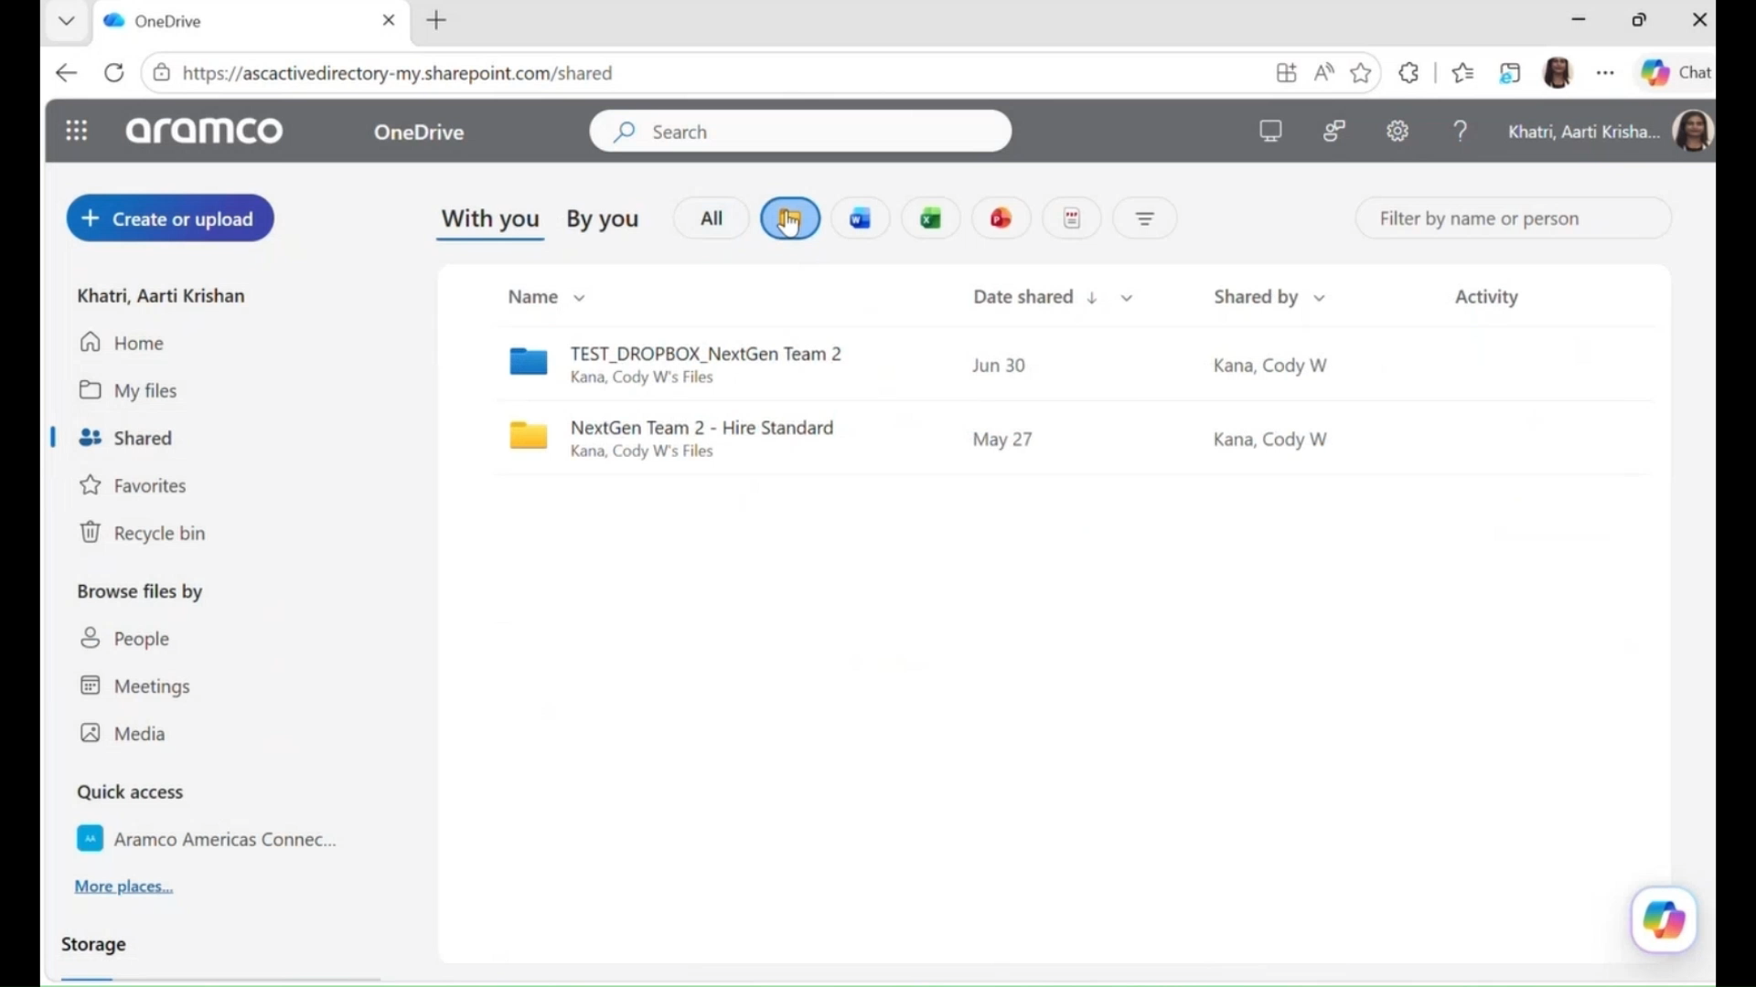
Solution Design
HS
Solution Walkthrough
Data File Upload
SQL Processing
Ara Interactive Chatbot
Power BI Dashboard
05
Notes:
Our Cost Management Model is designed to make the process easier, more secure and more efficient for employees. A user starts by uploading a new file into a secure OneDrive folder. From there, the workflow moves the data into a SQL Database, where the information is organized into tables and stored on a more reliable and secure platform than Excel. We chose SQL over Excel because SQL can manage larger sets of data and provide access based on each employee’s approved security profile. Once the data is updated in the SQL Server, it connects to Power BI so the dashboard can refresh automatically. The model also includes our chatbot, Ara, named to align with Aramco and make the tool feel familiar and approachable for employees. Ara can help answer user questions, perform simple analysis and support forecasting.

Slide 5

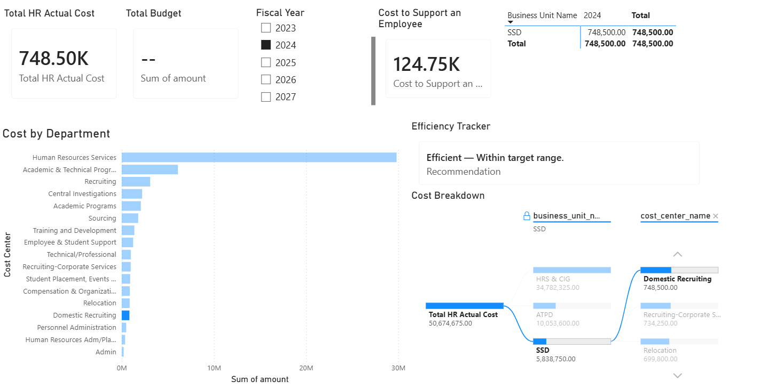

HS
Dashboard Preview
Produced in Power BI
06
Notes:
This Power BI dashboard is designed for supervisors, directors, leaders, and anyone responsible for managing a department budget. The dashboard is completely interactive, allowing users to filter by year, department, business unit and cost center. This helps budget owners better understand where money is being allocated and gives them a clearer view of spending throughout the year. To be transparent, these are not real numbers yet. The display uses sample data provided by HR for this presentation.

Slide 6
HS
Timeline
Implementation Roadmap
Month 1-3
Month 3-4
Month 5-6
Month 7
Data Integration
Quality Control
Test & Customize
Go-live
07
Notes:
We have a seven-month timeline leading up to the dashboard’s go-live date.
Months 1–3 are the Data Integration period, which serves as the planning phase. During this time, HR, Finance and IT will work together to determine what data needs to be included in the dashboard.
Months 3-4 are dedicated to Quality Control, where the team will test the accuracy of the information before the dashboard goes live.
Months 5–6 are the Testing and Customization period, where the dashboard’s appearance, content and functionality will be adjusted to meet each department’s needs.
Month 7 is the go-live rollout period, when the dashboard will be launched for supervisors, directors, leaders and other budget owners to begin using.

Slide 7
HS
Acknowledgement & Questions
We would like to thank the following people for their guidance and support throughout this project:
Special Thanks
IT Support
HR Guidance
PA Guidance
Questions?
Mirza Baig
Brian Master
Andy Chauvin
Mahaboob Shaik
Kristen Bowlin
Eva Chang
Rola Elzoor
Stephanie Palmer
Michelle Flores
08
Notes:
On behalf of Hire Standard
We would like to thank the following people for their guidance and support helping us navigate through this project, it wouldn't be what it is without them. We would now like to open the floor to any questions you may have.

